Slide 1





Spice Garden
Understanding the customer before promoting the brand.

Slide 2

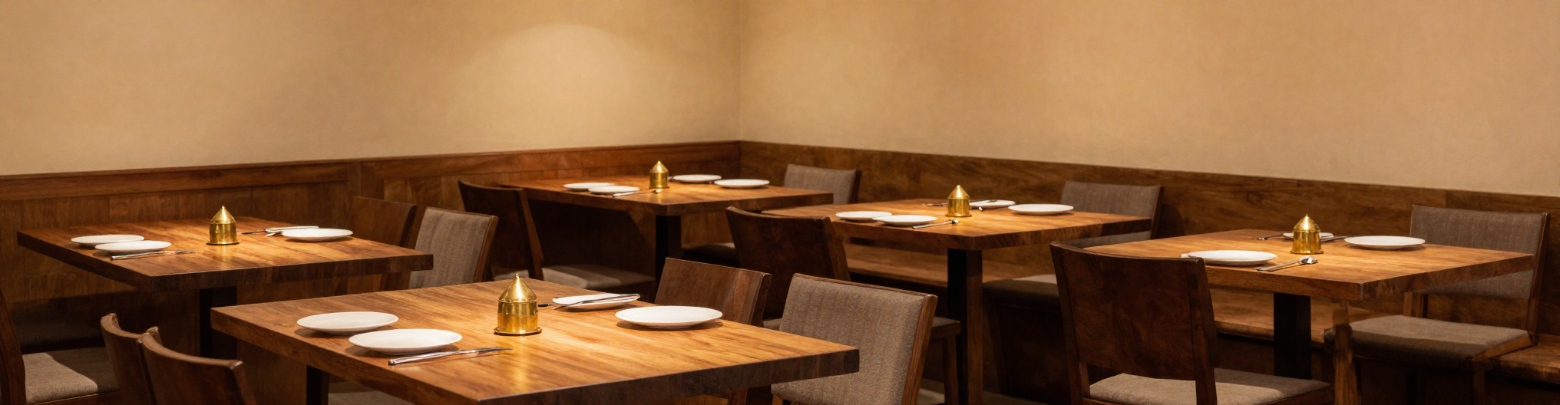


3
Core
Goals
Meet
Spice
Garden
Restaurant & Food Service Who They Are
Spice Garden is a dine in and takeaway restaurant serving flavourful, affordable meals to a broad everyday audience students, families, and office goers. Their core goals are to attract new customers increase sales volume and build a recognisable local brand presence through both digital and on-ground marketing.

Slide 3
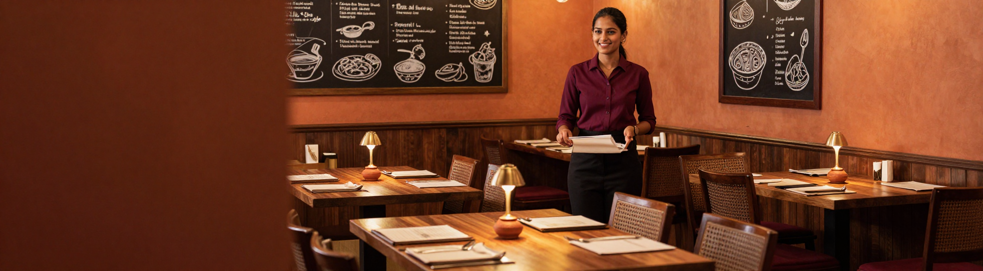


Introduction
to Marketing
What Is Marketing & How Does It Work?
Marketing is the process of understanding your customer communicating your value and building lasting relationships. The journey flows Understand → Attract → Engage → Convert → Retain. Traditional Marketing uses flyers, banners & local newspaper ads for physical reach. Digital Marketing uses Instagram, Google Ads, social media & influencer marketing for wider, targeted reach.
5-Step
2-Way
Marketing Journey: Understand → Attract → Engage → Convert → Retain
Traditional vs Digital: Local Reach vs Global Targeted Reach

Slide 4

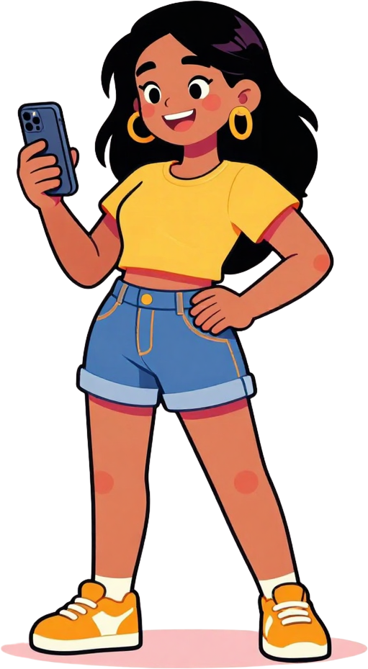

Marketing Activities
Social Media & Digital Ads
Instagram content, Google Ads, and influencer marketing to grow Spice Garden's online reach.
Festival Offers & Corporate Deals
Seasonal promotions, festive combos, and corporate bulk-order packages to drive repeat business.
Local Presence & Flyers
Flyers, banners, and on-ground visibility to capture walk-in customers and build local brand awareness.

Slide 5

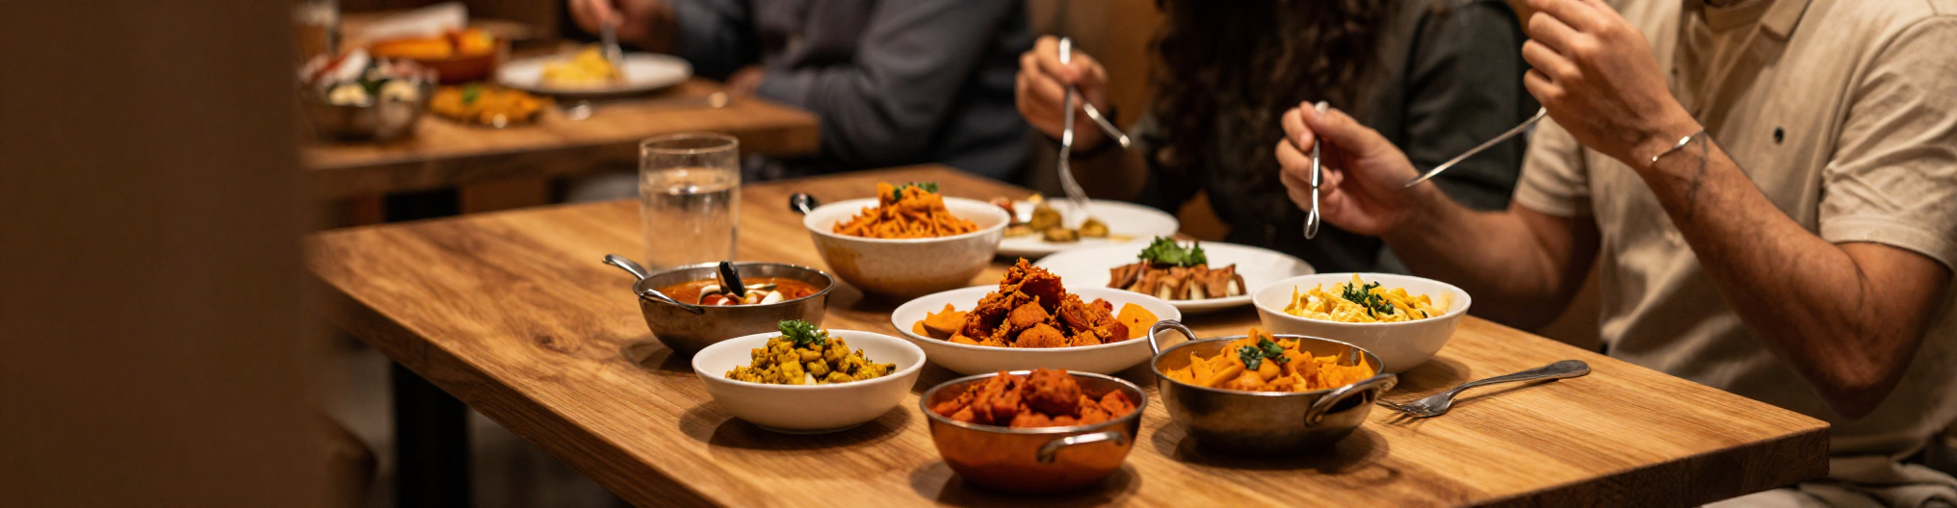
5 Reasons
Customer Lens
Think Like a Customer
Why Customers Choose Spice Garden
Customers choose Spice Garden for good food affordable pricing a welcoming ambience exciting offers & deals and everyday convenience. At the core every customer wants food value and experience understanding this is the foundation of great marketing.

Slide 6

Identifying Customers
Students & Families
Students seek affordable meals families look for comfort variety and a welcoming dining experience.
Who walks through Spice Garden's doors?
Office Employees & Couples
Office employees need quick meals during breaks couples value ambience, experience and special offers.
Event Organizers & Corporates
Event organizers and corporate clients require bulk orders packages and reliable large-group catering.

Slide 7
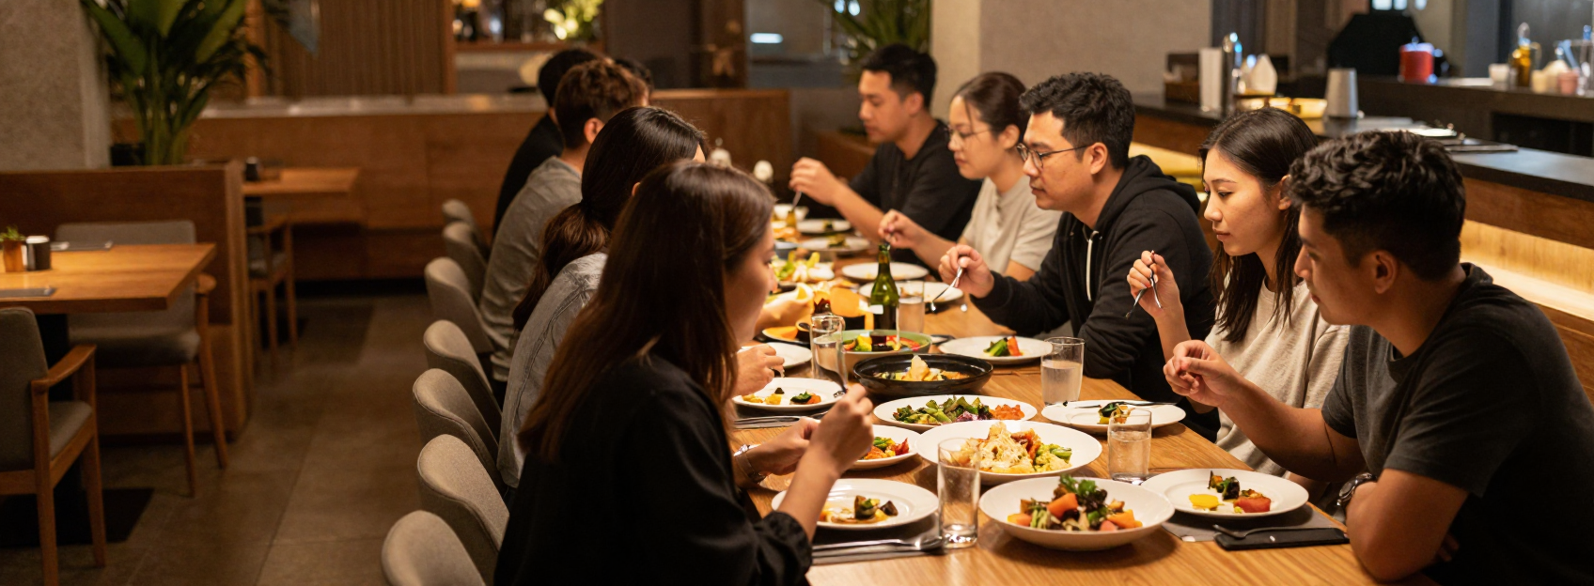

Customer Behaviour Patterns
Qualitative Insights Into How Customers Order
3 Key
Group size order value and occasion reveal key purchasing behaviour. Large groups may indicate events or corporate opportunities. Higher order values suggest bulk or group purchases. Occasion based orders create package deal opportunities
Insight Categories

Slide 8
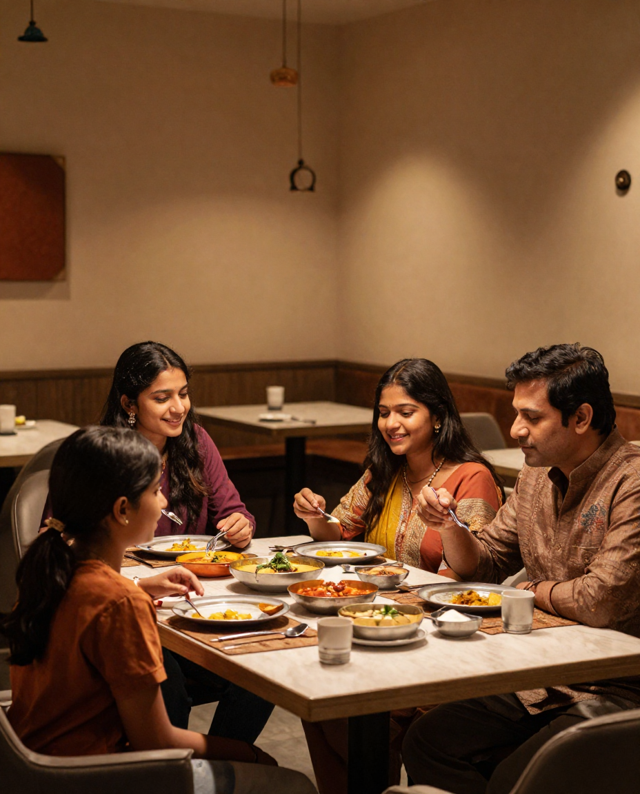
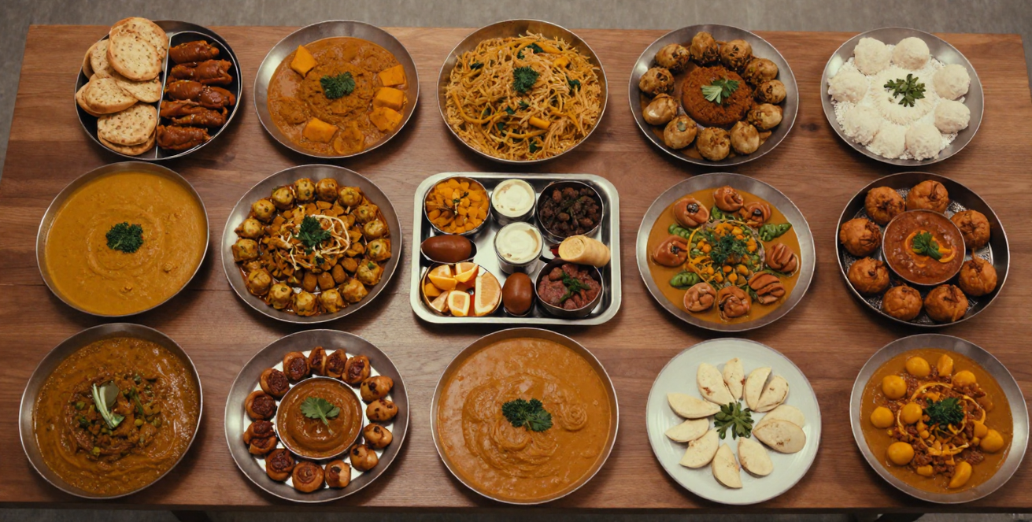
B2C vs B2B
Customers
Two Sales Opportunities for Spice Garden
B2C (Business to Customer) Families,students, couples, individuals & office employees regular daily dining, everyday orders, consistent footfall.
B2B (Business to Business) Corporate clients, event organizers & bulk-order clients arger orders, higher value, special packages.

Slide 9

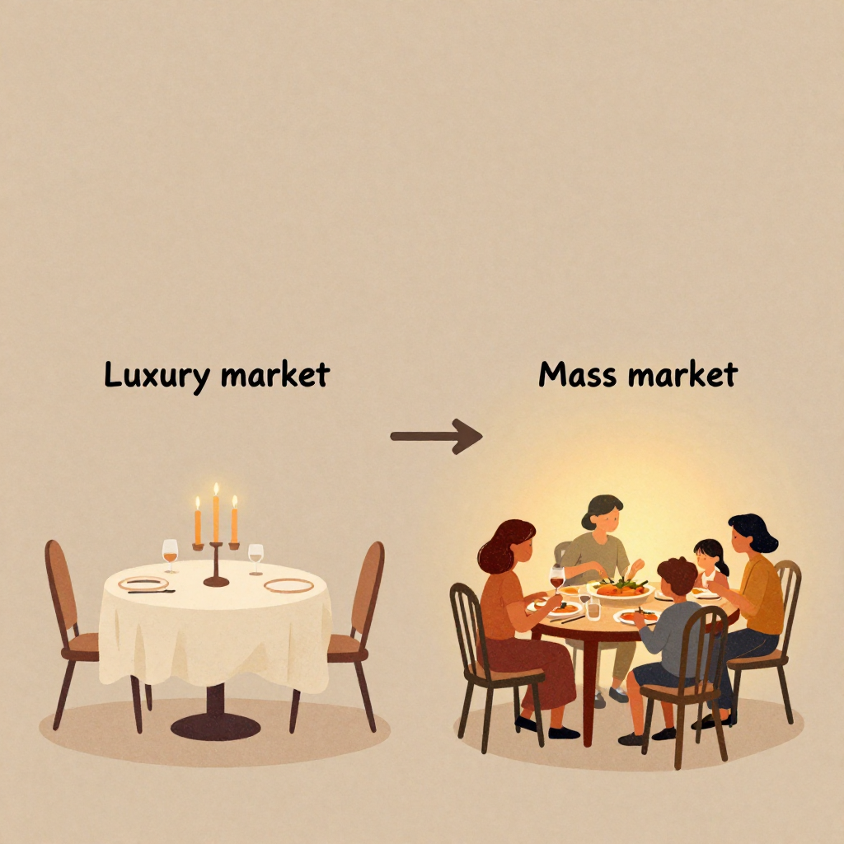
Market
Segmentation
Luxury Market vs Mass Market
Luxury Market: premium pricing, exclusive experience, high spending, niche audience.
Mass Market: affordable pricing, wider audience, everyday dining, low-medium spending. → Spice Garden is a Mass Market brand — accessible pricing and a broad, diverse customer base make it ideal for high volume, everyday dining.

Slide 10
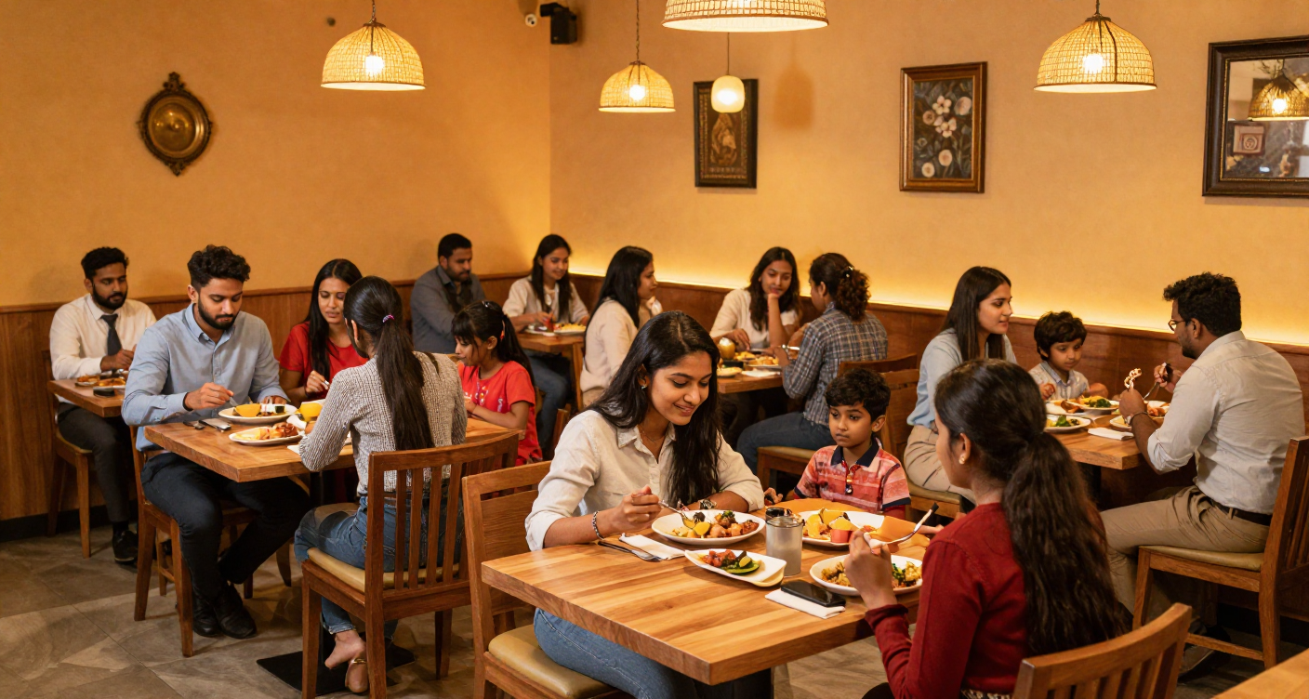
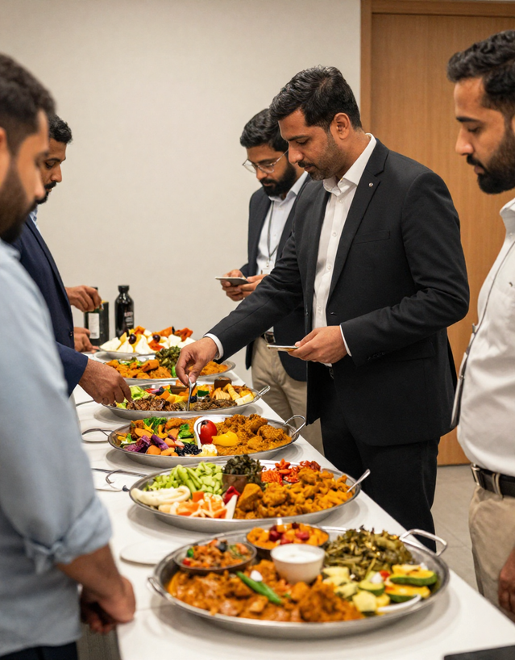
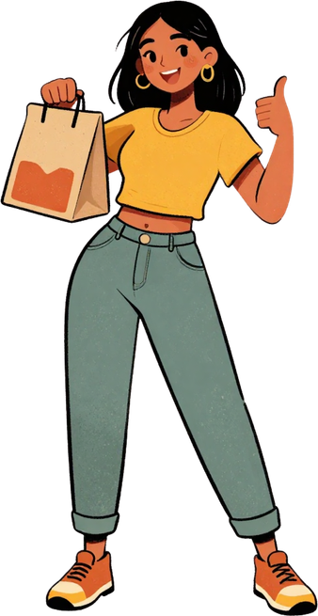
Customer Segment Overview
Spice Garden Who We Serve
Spice Garden sits at the centre of a diverse customer map: Students & Families for everyday dining, Office Employees & Couples for regular visits, and Event Organizers for B2B bulk orders. Everyday dining drives consistent revenue B2B/event clients drive larger order values.

Slide 11
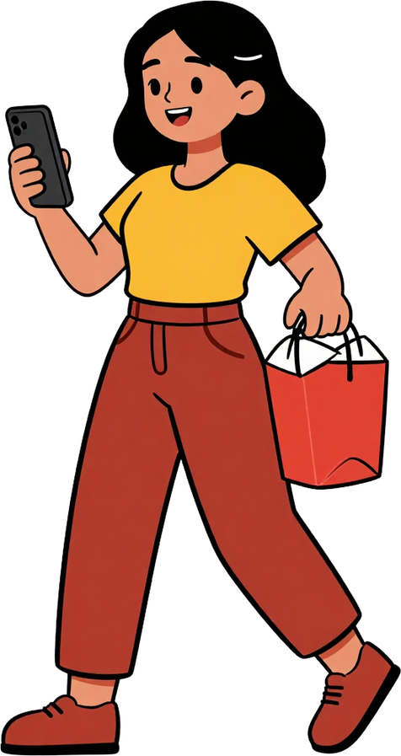
Key Marketing Insights
B2C
Mass Market Audience
B2B
Right Customer. Right Message. Right Channel.
Corporate Opportunity
Spice Garden operates in the Mass Market with a strong B2C base students, families, couples and office employees.
A growing B2B opportunity exists through corporate clients and event organizers. Digital channels like Instagram, Google Ads and influencer marketing amplify reach.

